Slide 1
Maths 2

Slide 2
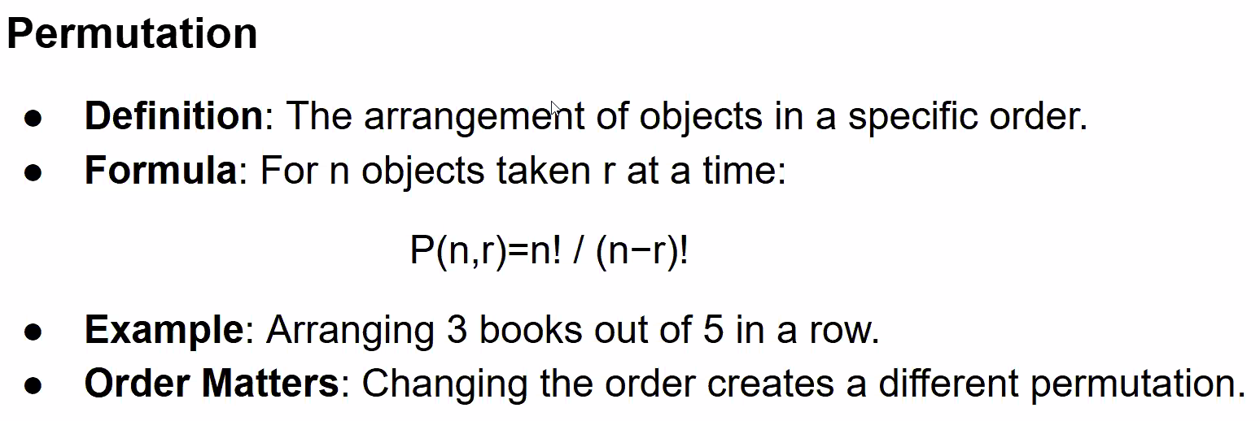
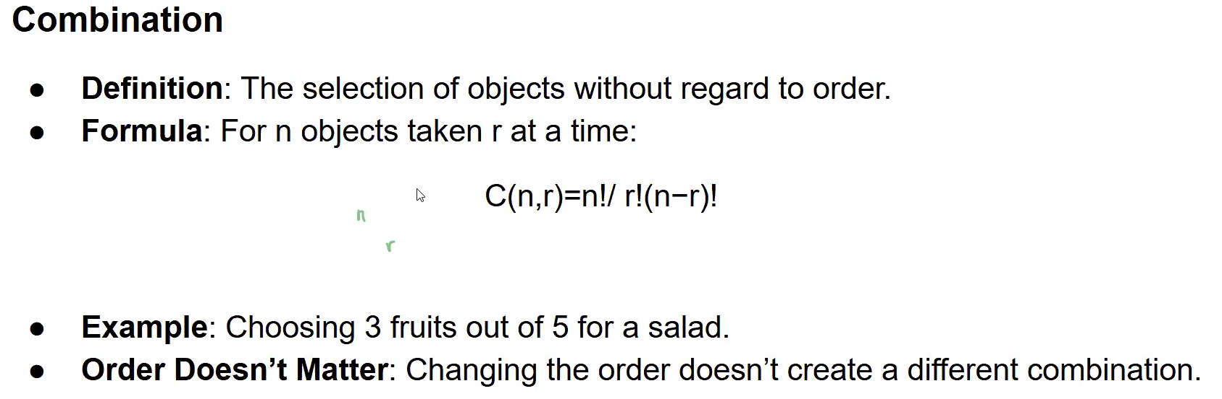

Slide 3
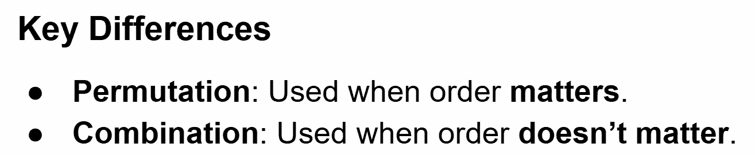
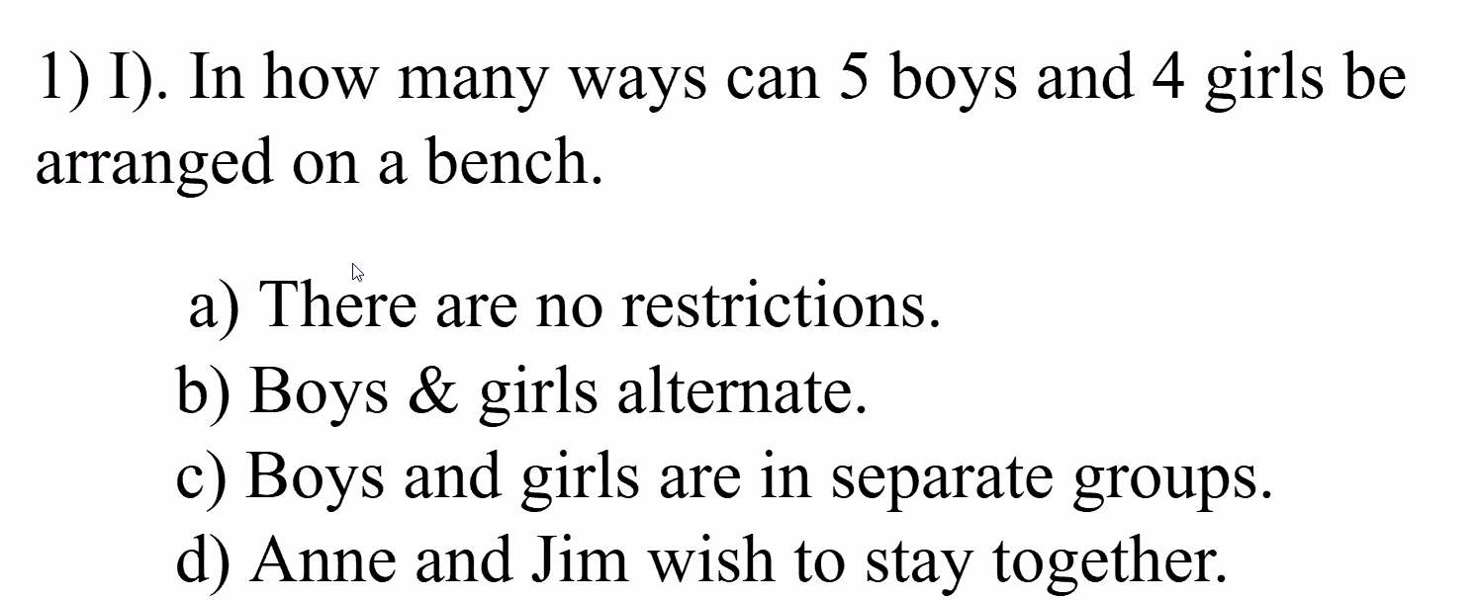

Slide 4
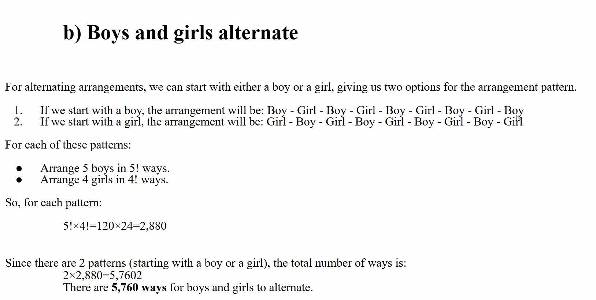

Slide 5
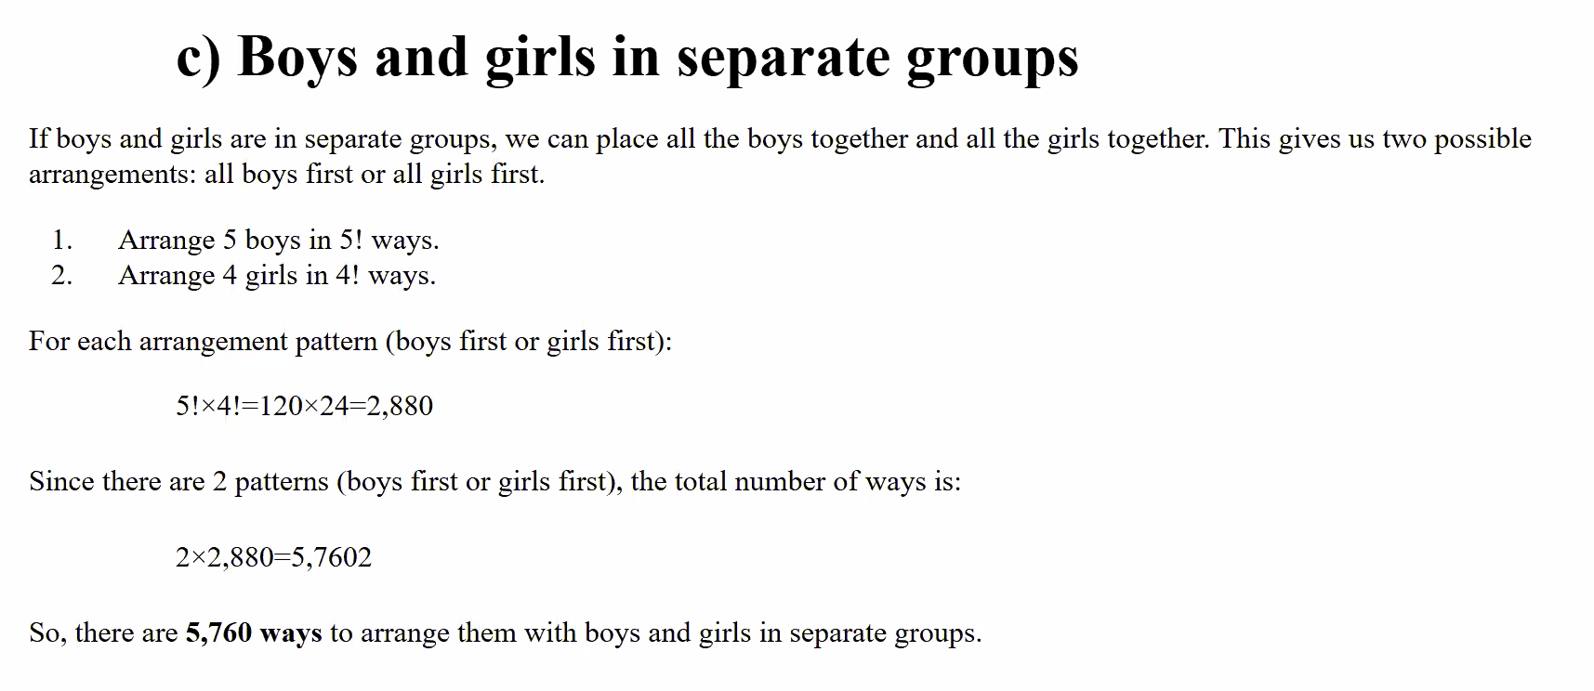

Slide 6
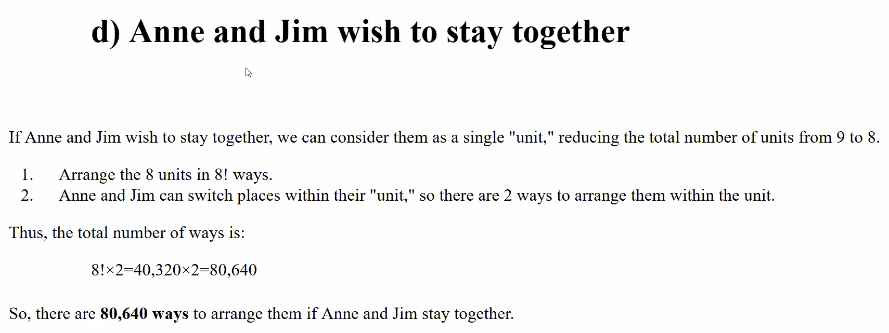

Slide 7
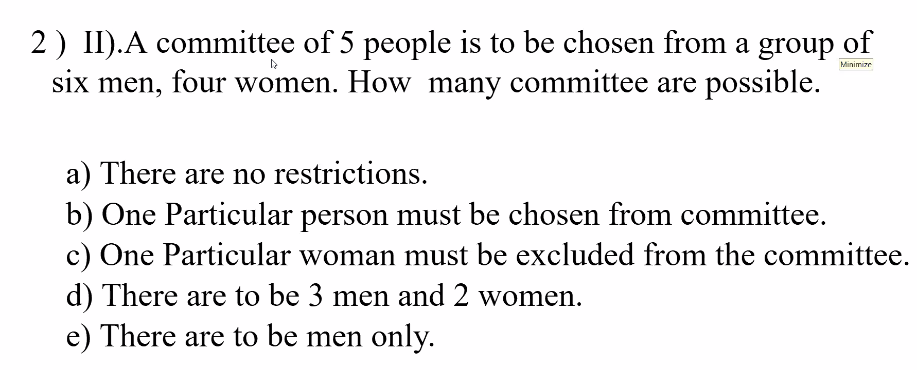

Slide 8
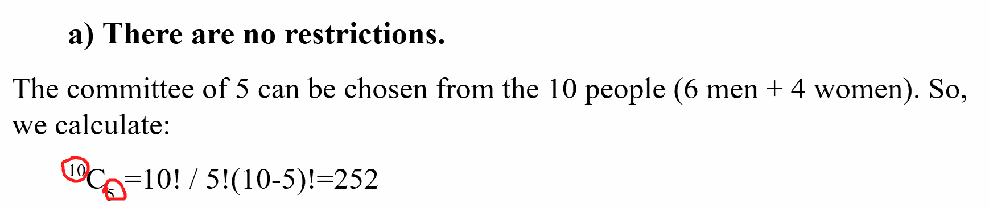
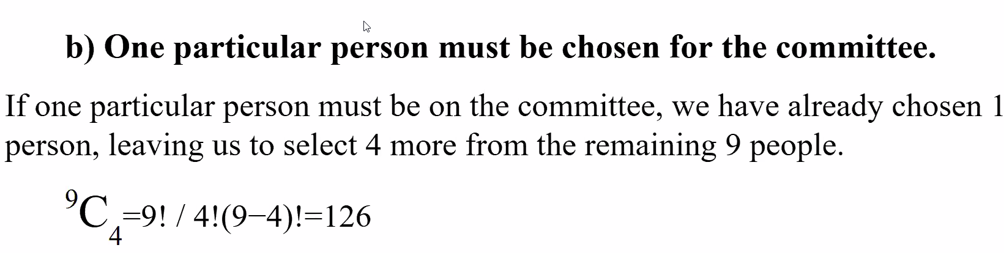

Slide 9
a) No restrictions:
Total people: 6 men + 4 women = 10 people
Committee size: 5 people
Combinations: ¹⁰C₅ = 10! / (5! * 5!) = 252
b) One particular person must be chosen:
Remaining spots: 5 - 1 = 4
Remaining people: 10 - 1 = 9
Combinations: ⁹C₄ = 9! / (4! * 5!) = 126
c) One particular woman must be excluded:
Remaining people: 10 - 1 = 9
Committee size: 5
Combinations: ⁹C₅ = 9! / (5! * 4!) = 126
d) 3 men and 2 women:
Men combinations: ⁶C₃ = 6! / (3! * 3!) = 20
Women combinations: ⁴C₂ = 4! / (2! * 2!) = 6
Total combinations: 20 * 6 = 120
e) Men only:
Men available: 6
Committee size: 5
Combinations: ⁶C₅ = 6! / (5! * 1!) = 6

Slide 10
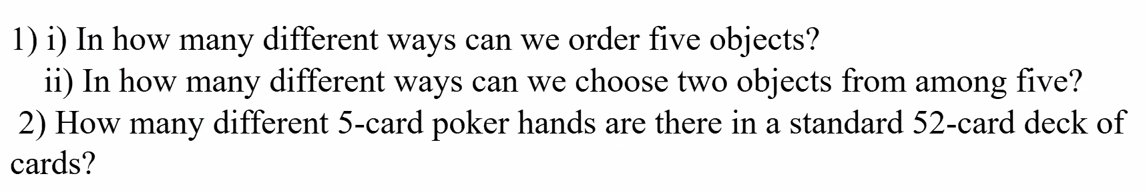

Slide 11
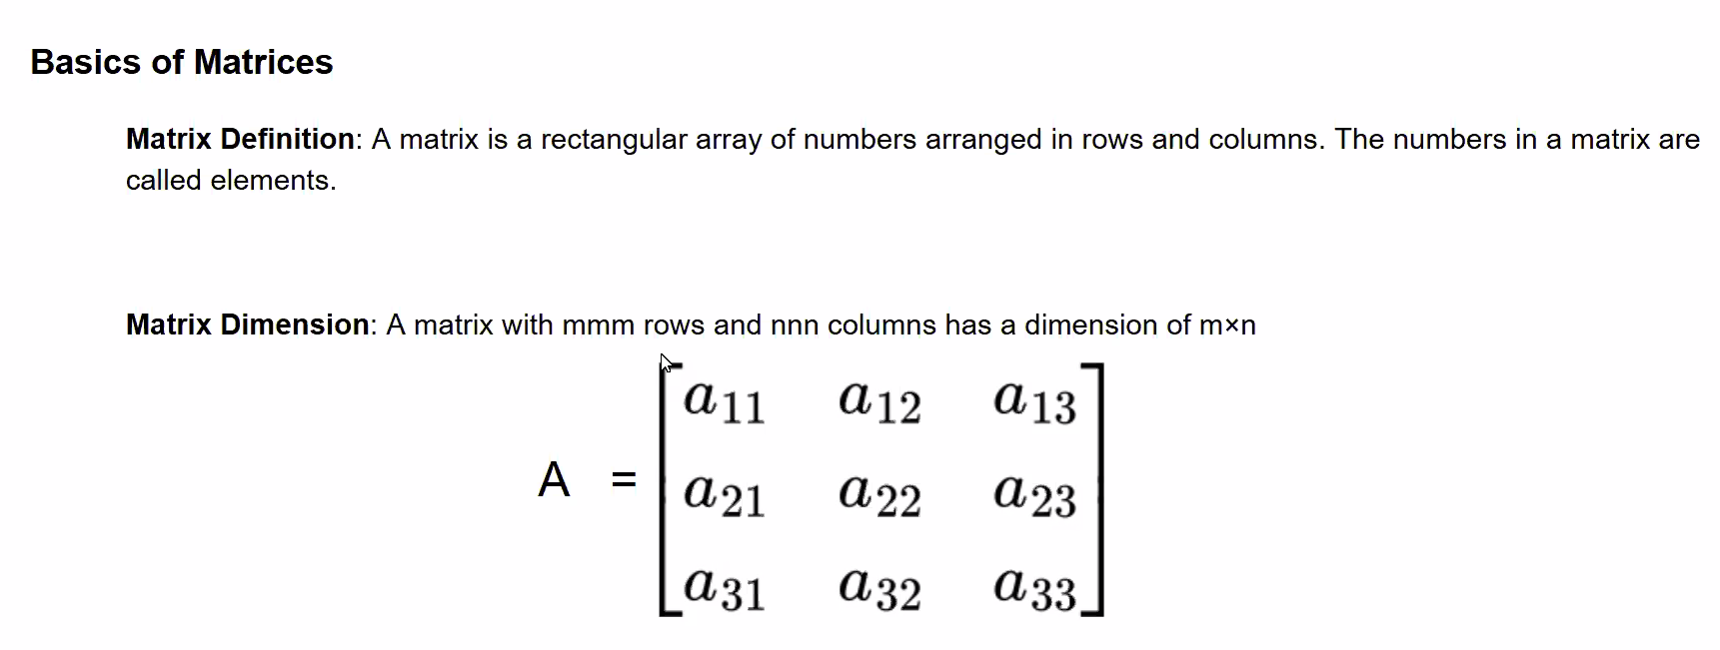

Slide 12
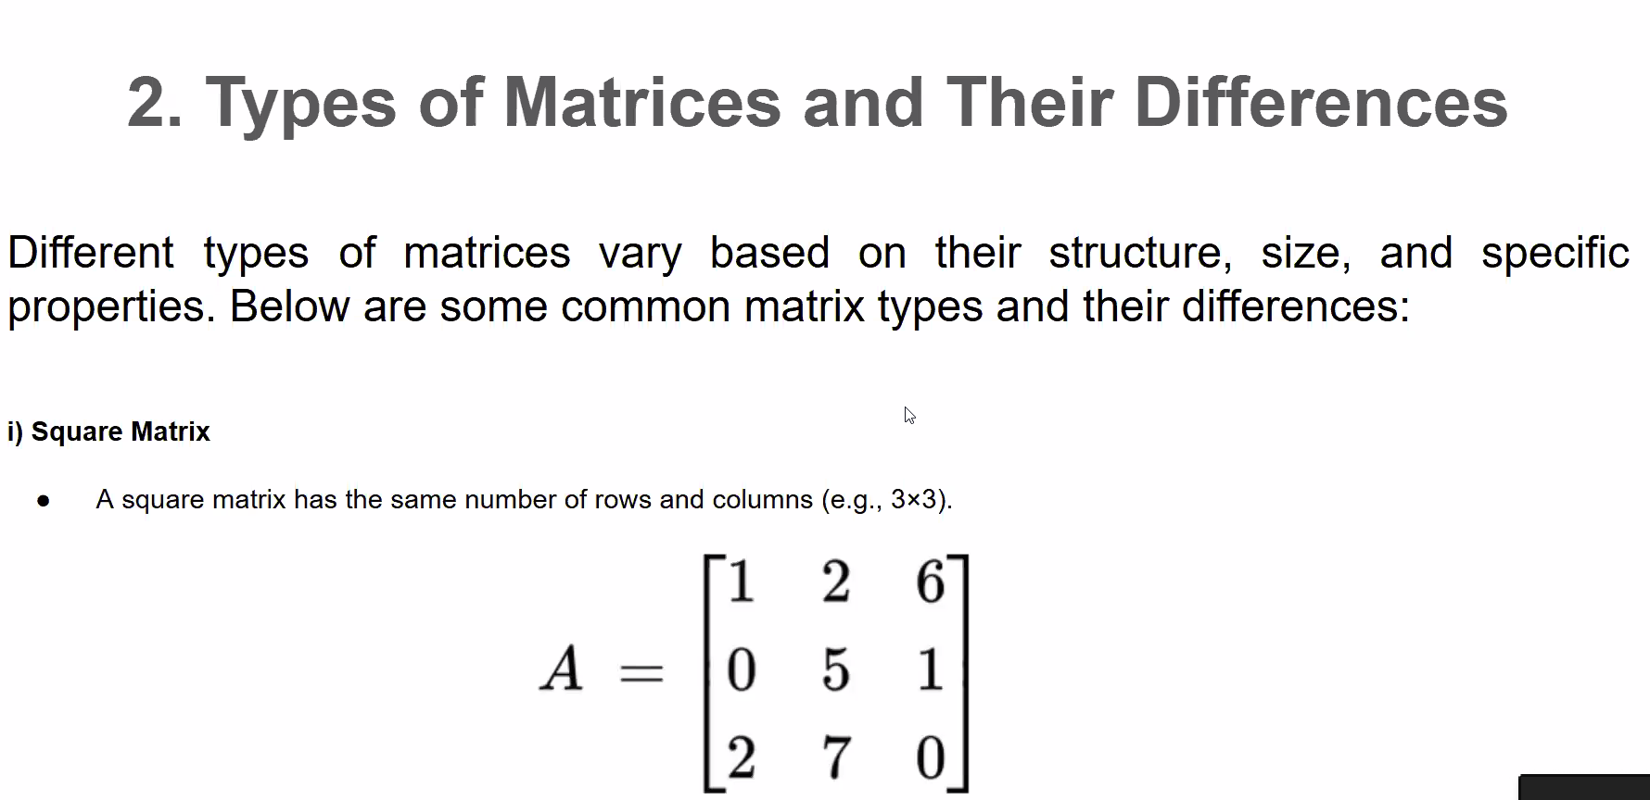

Slide 13
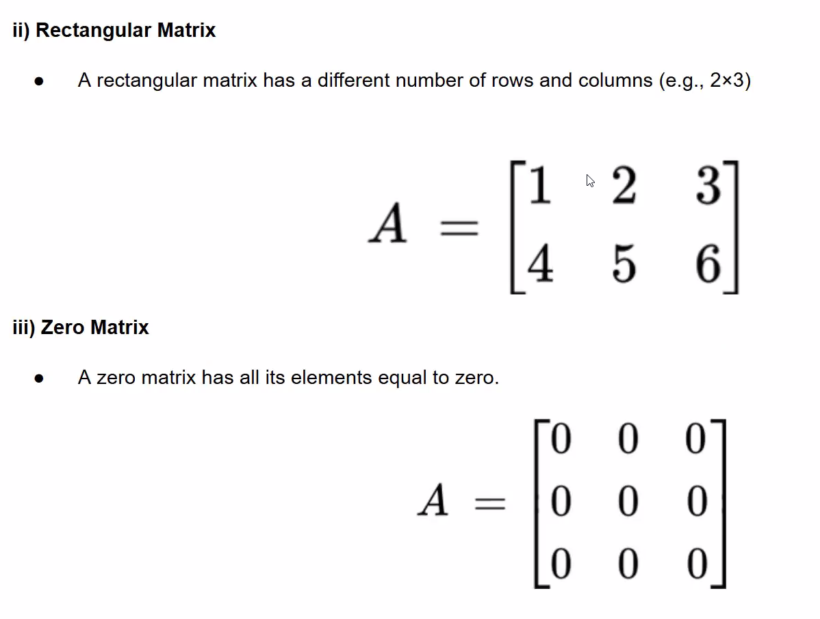

Slide 14
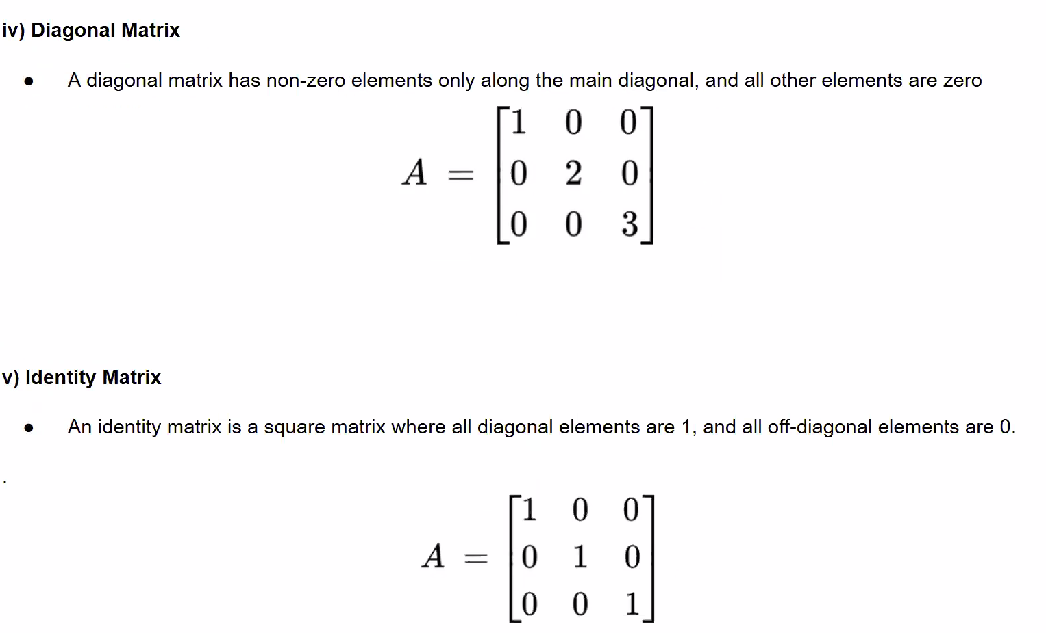

Slide 15
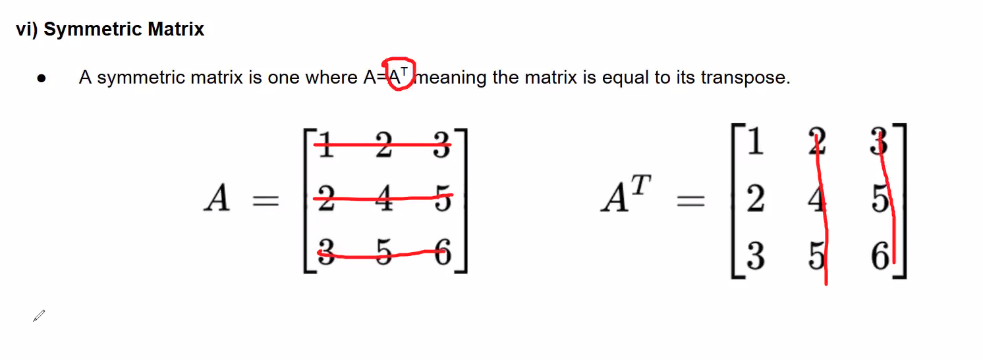
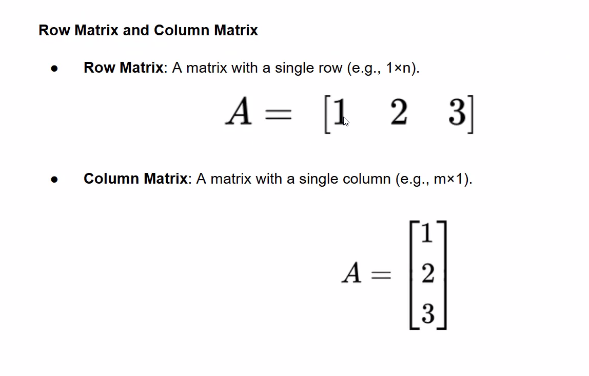

Slide 16
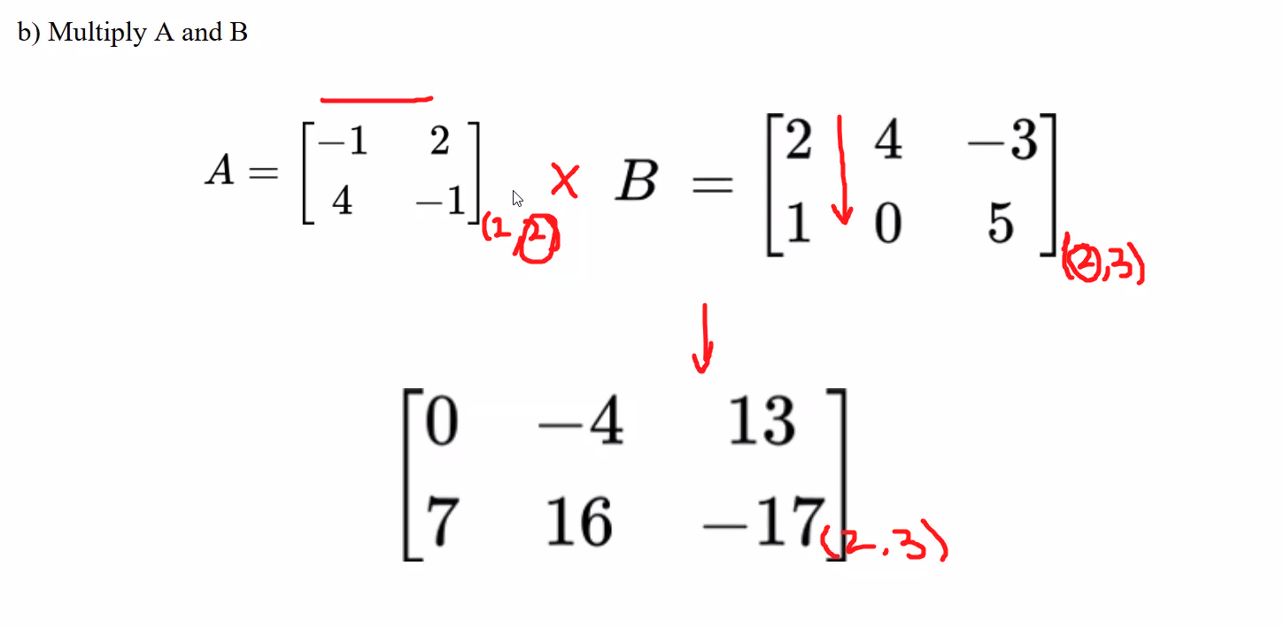

Slide 17
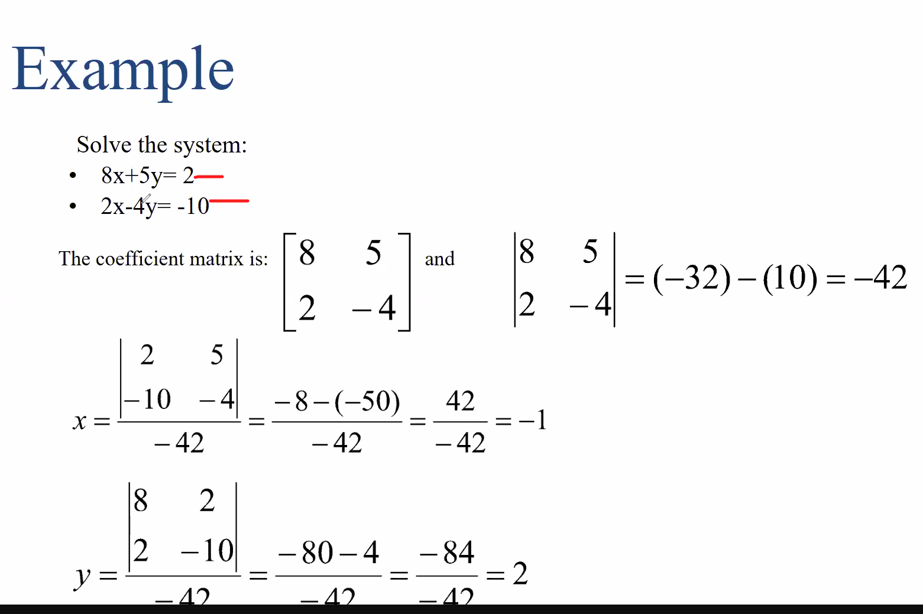

Slide 18
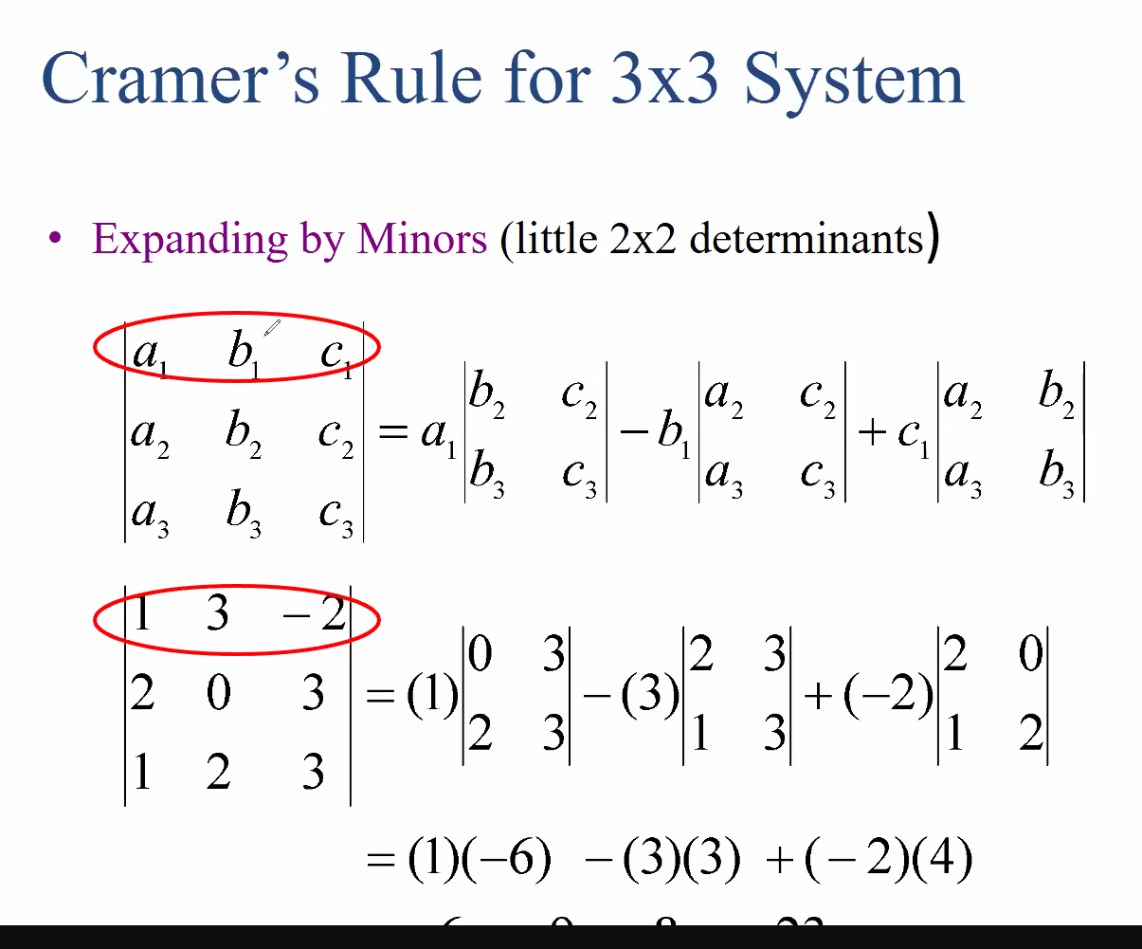
-6
-9
-8
= -23

Slide 19
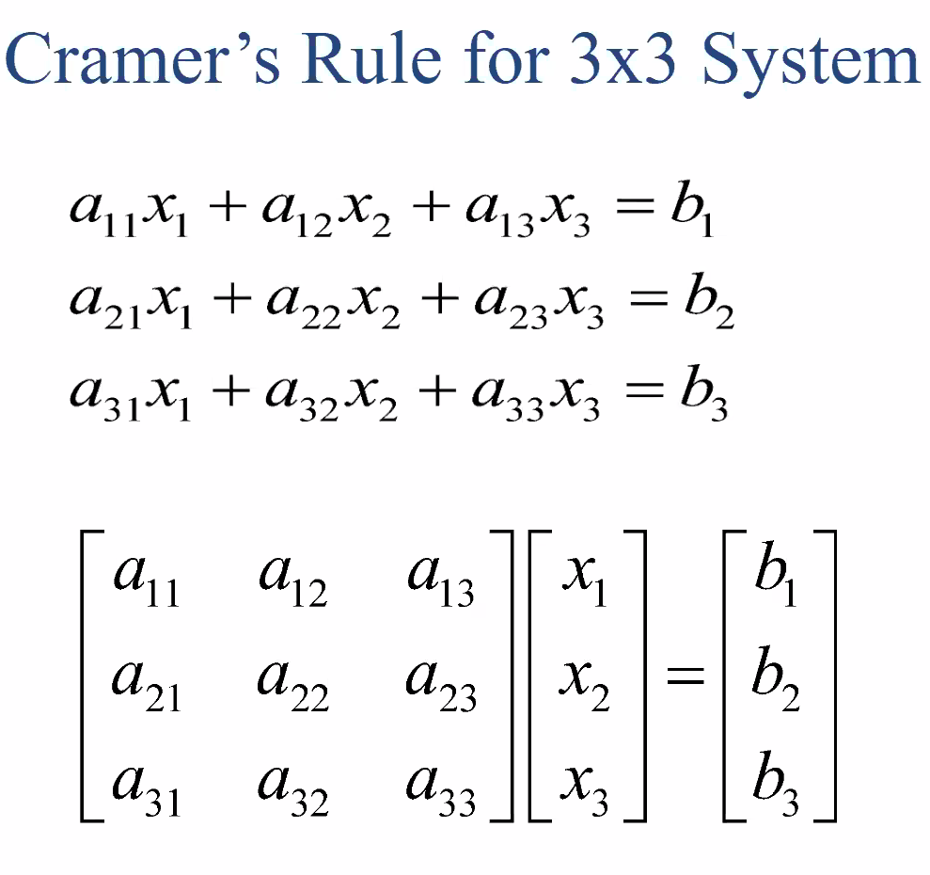

Slide 20
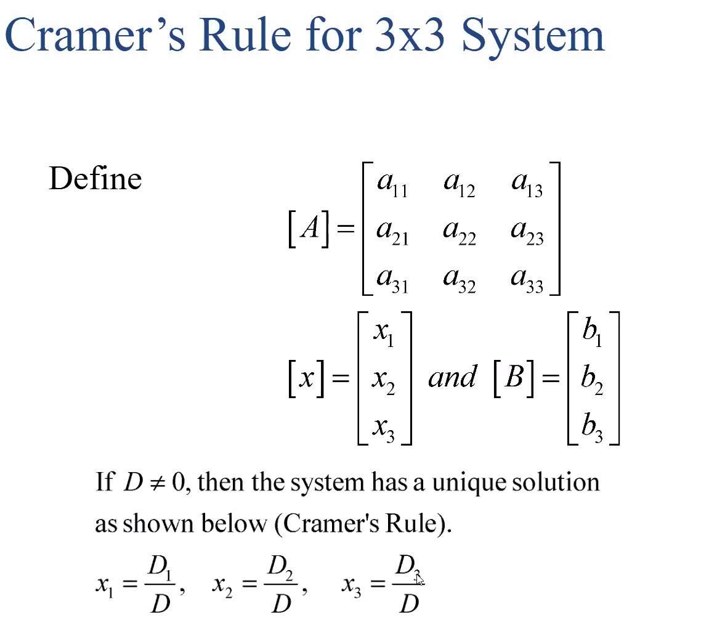

Slide 21
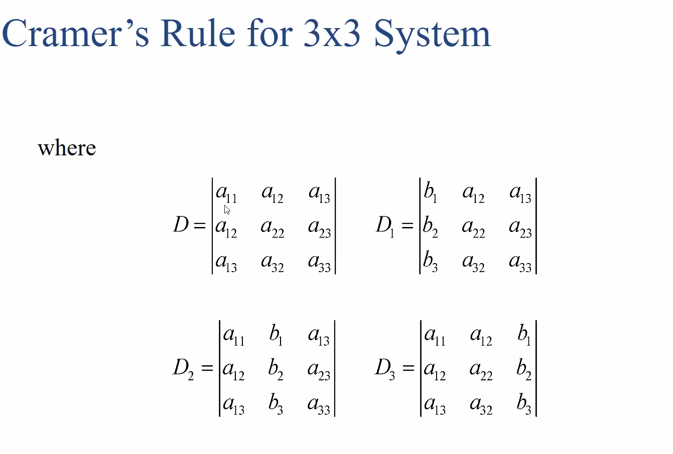

Slide 22
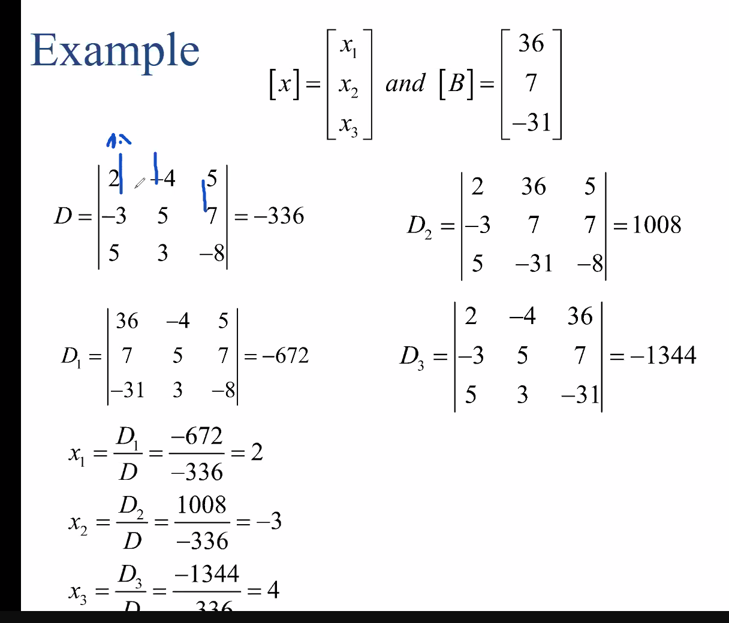

Slide 23
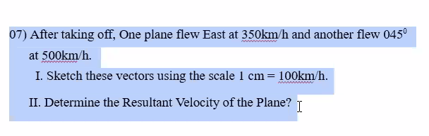

Slide 24
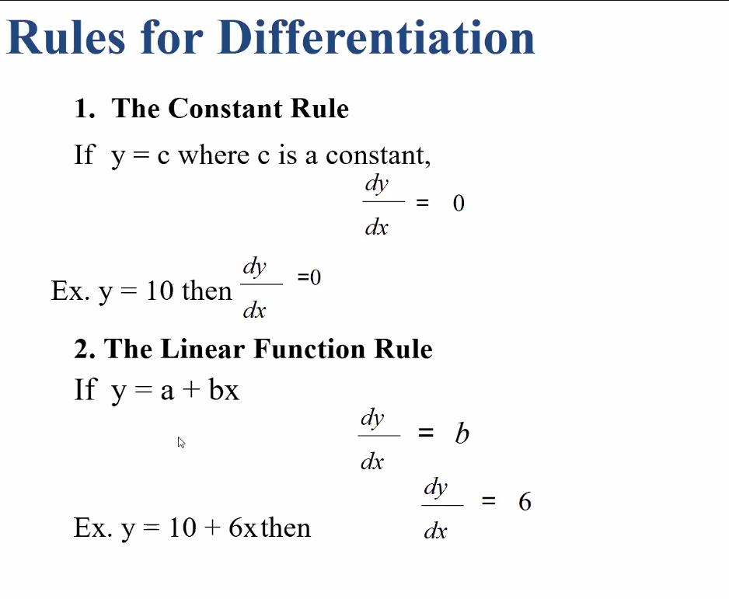

Slide 25
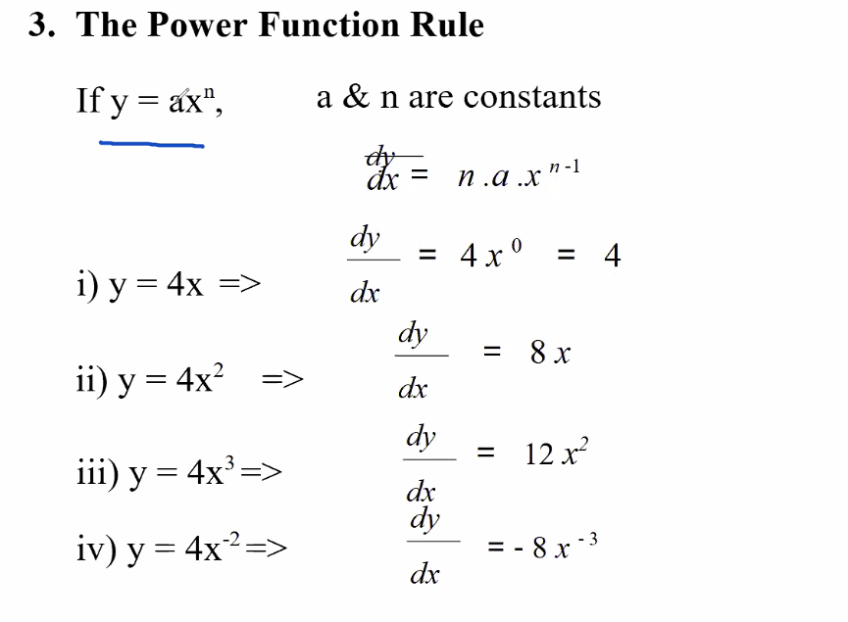

Slide 26
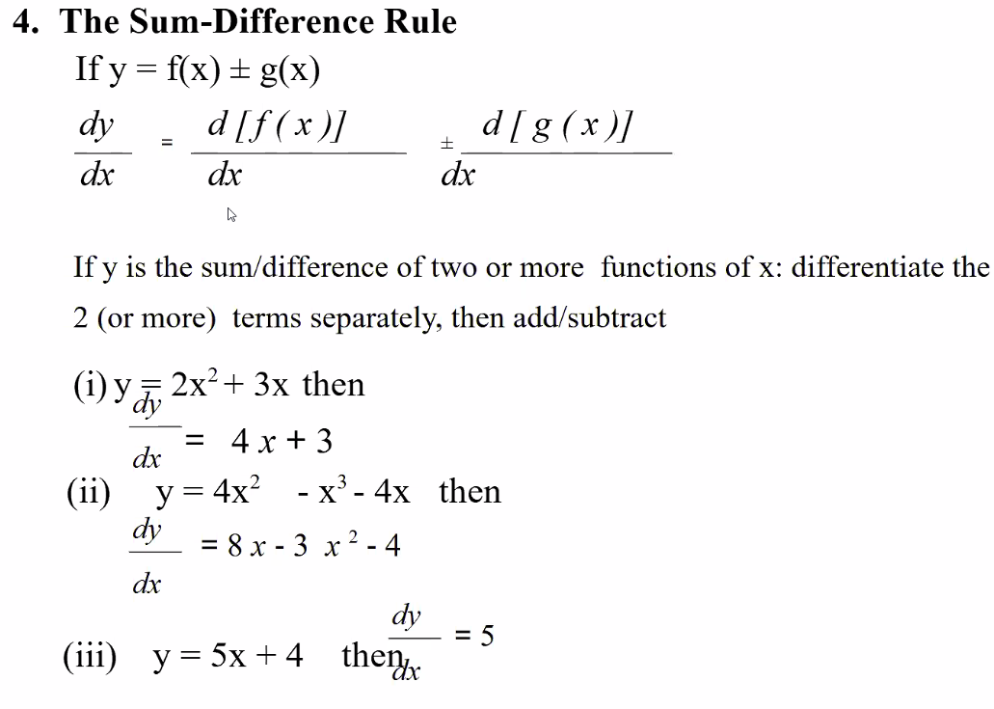

Slide 27
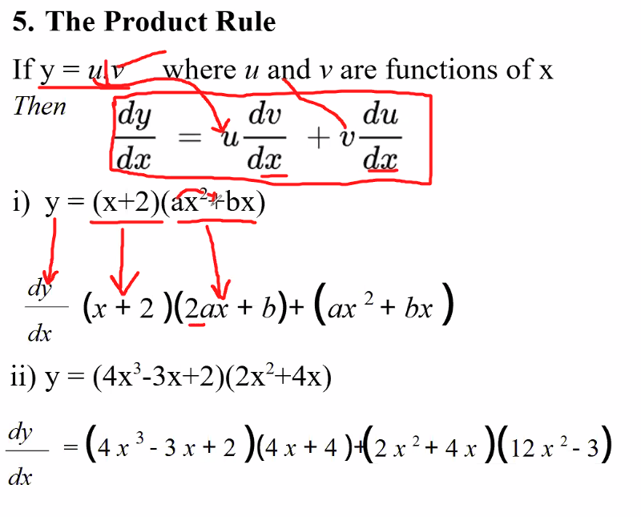

Slide 28
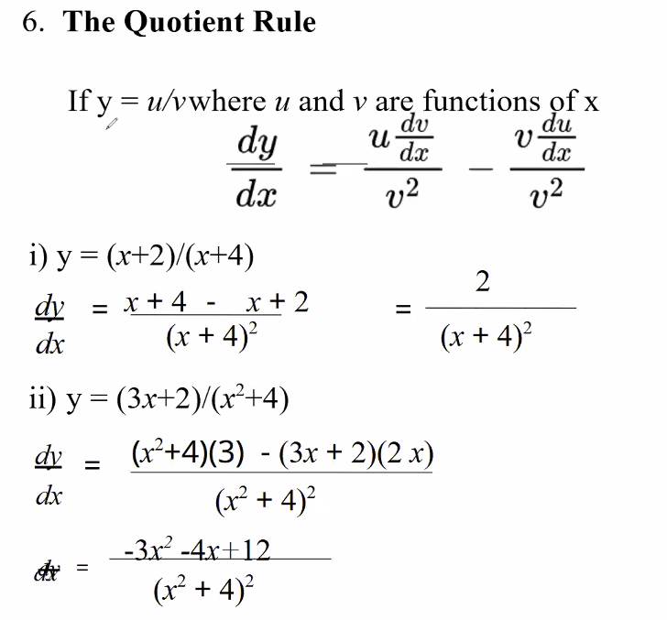

Slide 29
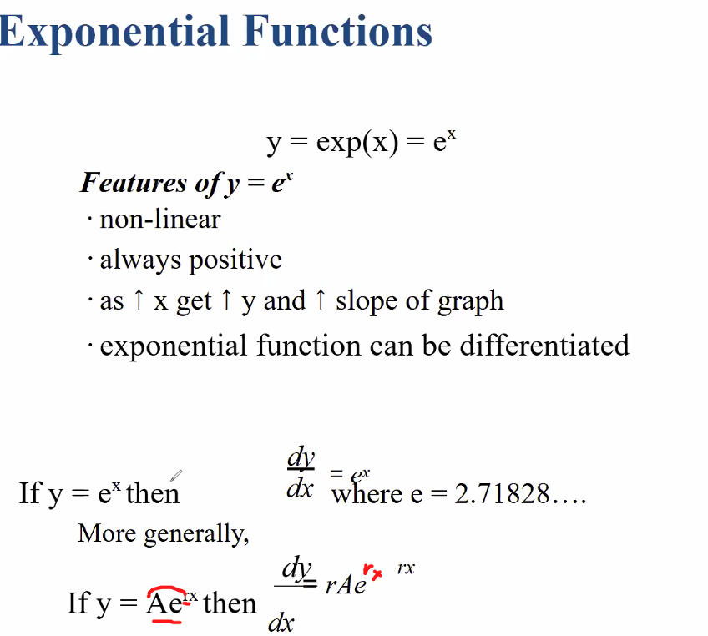

Slide 30
